Slide 1
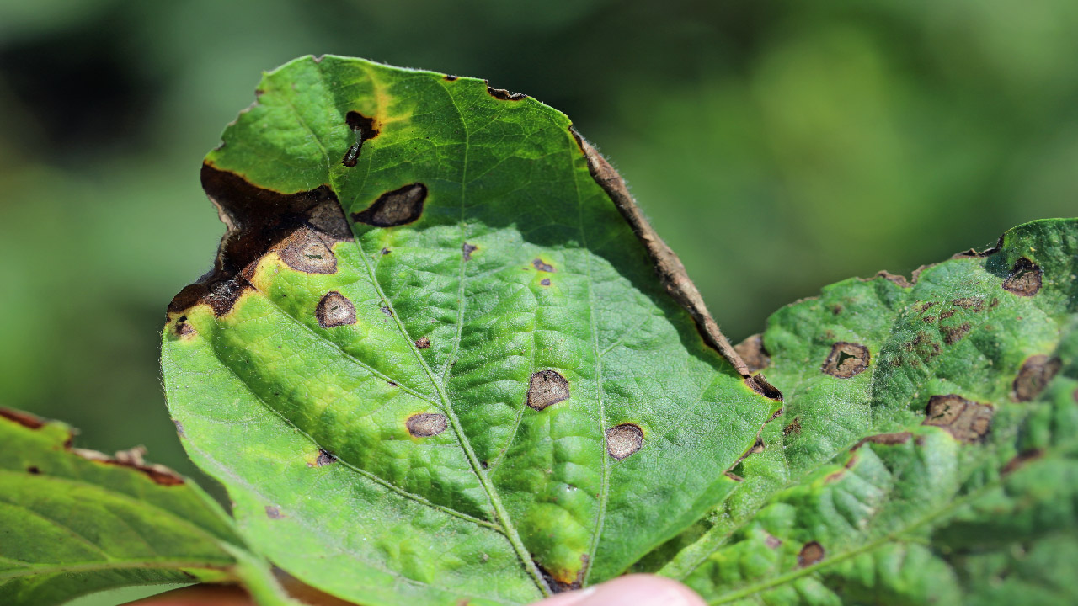
CLASSIFYING PLANT DISEASES
PIERRON Thomas, GAYGUSUZ Osman, VERNADE Mathias

Slide 2
TODAY'S DISCUSSION
Explore the dataset
Using CNN
Improvements
->ResNet
Conclusion
2

Slide 3


EXPLORE THE DATASET

Slide 4
EXPLORE THE DATASET
87k images of healthy and diseased crop leaves
Divided in 38 classes :
Apple___Apple_scab
Apple___healthy
Apple___Black_rot
Apple___Cedar_apple_rust
4
Notes:
Apple, blueberry, peach, grape, raspberry, tomato, etc. 12 Healthy, 26 diseased 31%

Slide 5
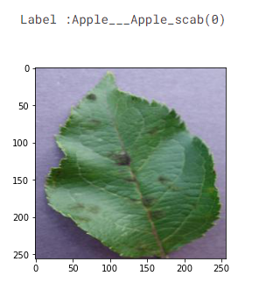
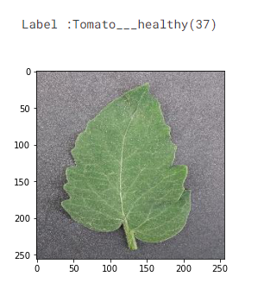
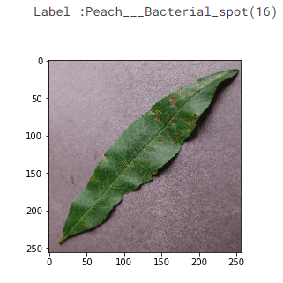
EXPLORE THE DATASET
Some image examples :
5

Slide 6
EXPLORE THE DATASET
87k images of healthy and diseased crop leaves
+
80%
20%
Directory containing 33 test images created for prediction purpose
Training set
Validation set
70295 files
17572 files
6
Notes:
divided into 80/20 ratio of training and validation set

Slide 7
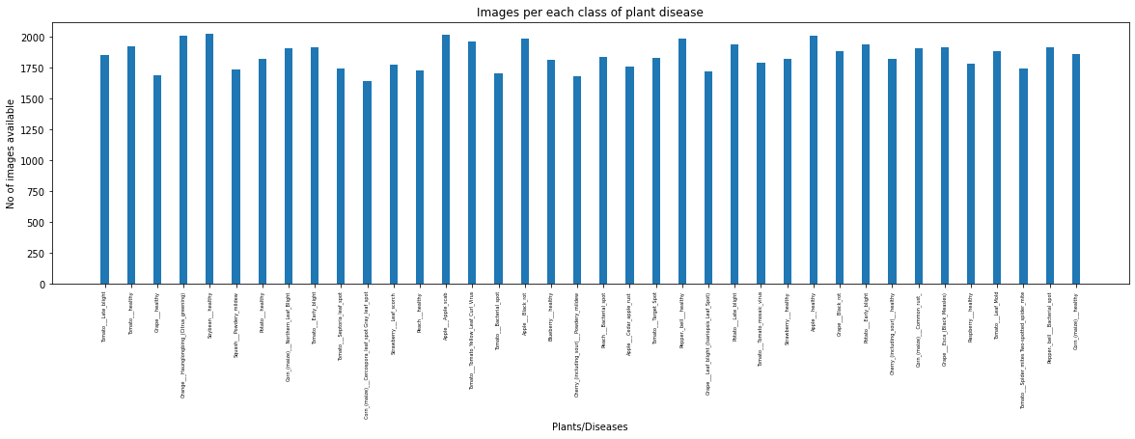
EXPLORE THE DATASET
Number of images per class of plant disease
7
Notes:
Homogenous -> no pb with overfitting

Slide 8
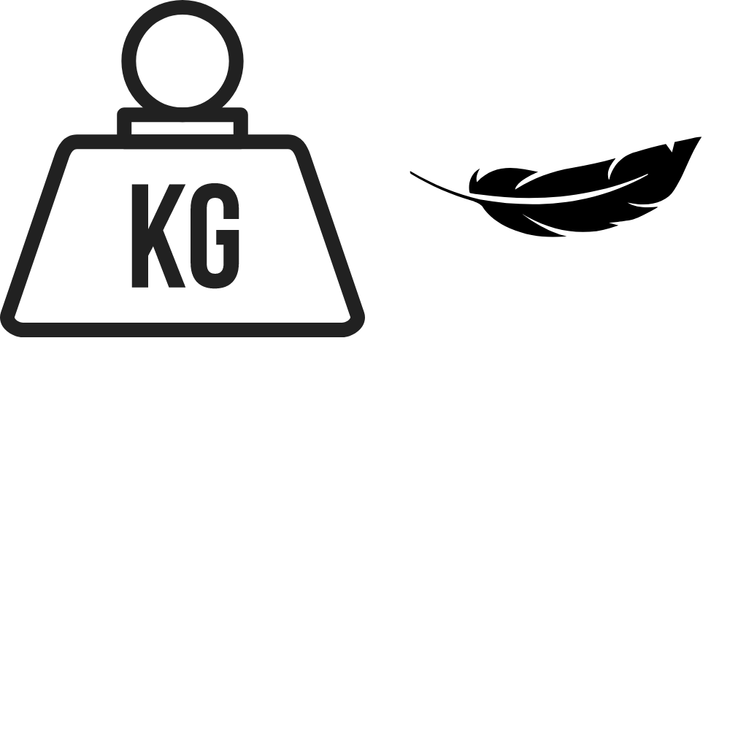
PRE-PROCESSING
Initial images’ dimensions : 256x256 pixels
New images’ dimensions : 128x128 pixels
8
Notes:
Preprocessing now : 256x256 images sizes
And we convert into 128 pixels because there is a lot of images

Slide 9
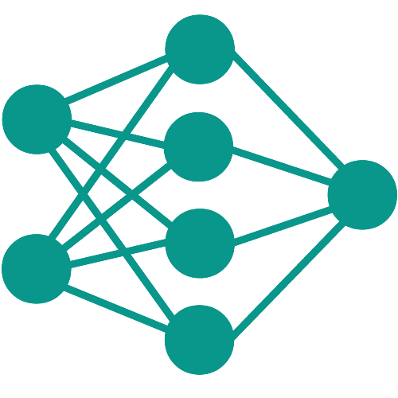
USING CNN

Slide 10
USING CNN
Construction of our CNN :
We used convolution modules :
Convolution module
Convolution module
Pooling layer
Convolution layer
Convolution layer
Convolution layer
Convolution layer
Padding : same
No padding
Maximum pooling
Padding : same
No padding
10
Notes:
Using two convolution layers with and without padding is a technique to maximize feature extraction.
The maximum pooling is useful for capturing the most dominants features.

Slide 11
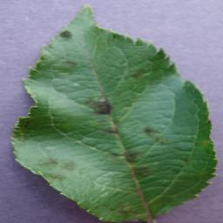
USING CNN
Construction of our CNN :
4 convolution modules using ReLu activation function and an output layer using softmax :
18,2
Apple___Apple_scab
0,94
Apple___Apple_scab
CNN
SOFTMAX
Apple___Black_rot
0,04
Apple___Black_rot
12,0
Apple___healthy
0,01
Apple___healthy
-2,0
11

Slide 12
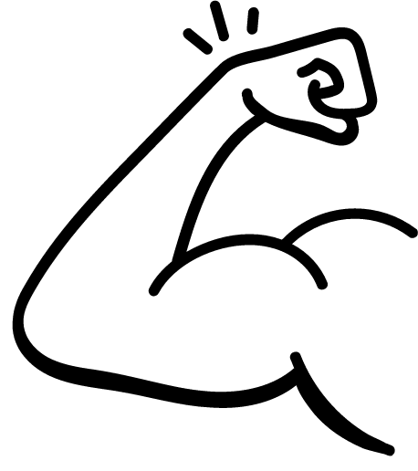
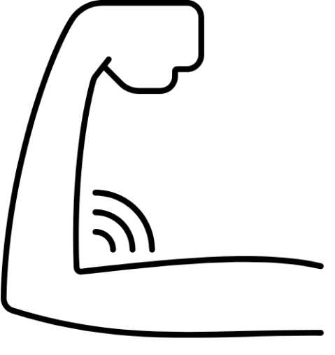
USING CNN
After our first results we observed :
CNN with 4 convolution modules
CNN with 5 convolution modules
NOT SUFFICIANT
BETTER
12
Notes:
On a commencé par 4 bloc de convolutions mais on n'a pas eu des assez bons résultats on avait besoins d’extraire plus de détails sur les images
Donc on a rajouté un autre bloc.

Slide 13
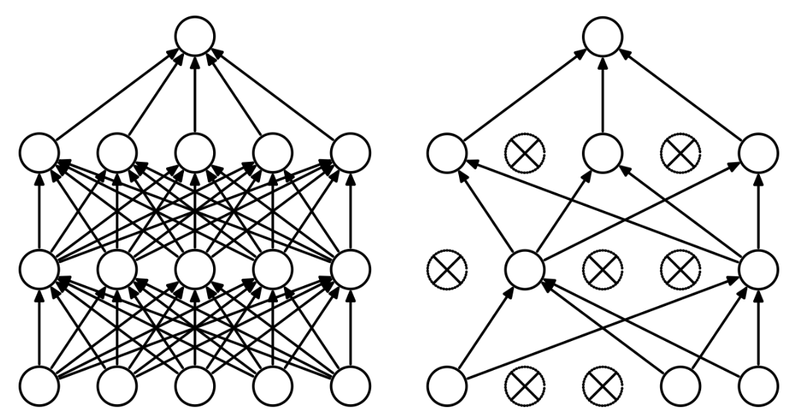
USING CNN
But, in order to avoid overfitting we used dropout method :
BEFORE DROPOUT, RISK OF OVERFITTING
AFTER DROPOUT
13
Notes:
Le choix des neurones à désactiver est aléatoire. On attribue une probabilité p à tous les neurones qui détermine leur activation.
Lorsque p = 0.1, chaque neurone a une chance sur 10 d’être désactivé. Nous on a utilisé 0,25 de proba = 25% de chance d’être désactivé.

Slide 14
USING CNN
We used these parameters to compile the model :
- Optimizer : Adam with a learning rate of 0,0001 to avoid overfitting
- Loss function : categorical cross entropy
For the training we used 10 epochs
Concerning the batchsize, we put it at 32
14
Notes:
The purpose of cross-entropy is to take the output probabilities (P) and measure the distance from the truth values.
batch_size is the total number of images given as input at once in forward propagation of the CNN. Basically, batch size defines the number of samples that will be propagated through the network.
We put it at 32 to have a good generalization.

Slide 15

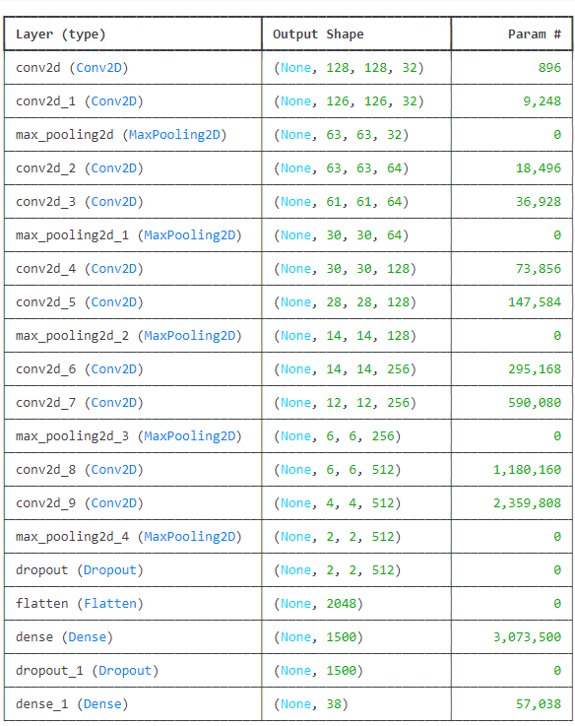
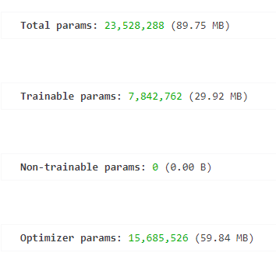
USING CNN
Finally, here is the structure of our model :
Convolution module
15

Slide 16
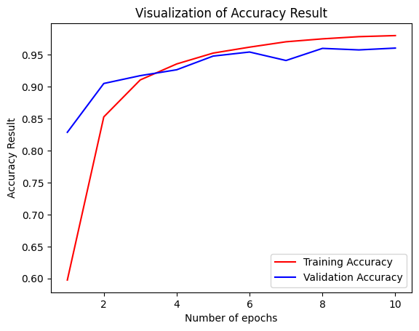
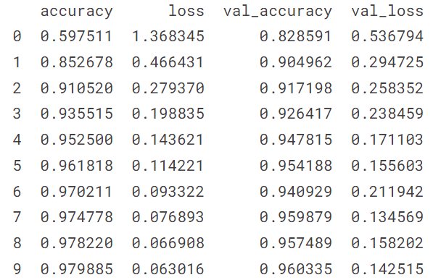
USING CNN
Results of our model on training and validation datasets :
On training dataset :
On validation dataset :
16

Slide 17
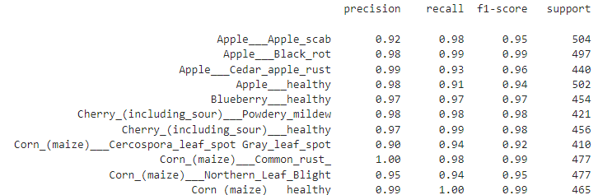
USING CNN
We looked at the result for each class using the validation set :
96% of accuracy on the validation set
17

Slide 18
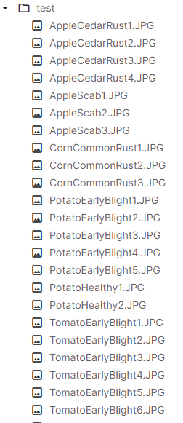
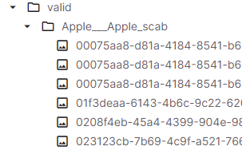
USING CNN
Let’s apply our model on the test directory :
First we had to use a different strategy
Structure of the test dataset :
Structure of the training and validation datasets :
The right class is the name of the file
The right class is the name of the directory
18

Slide 19
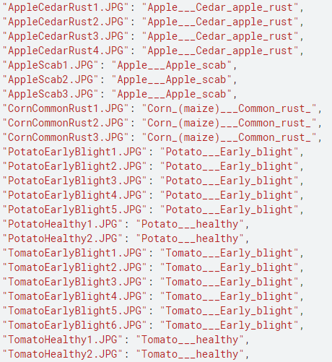

USING CNN
We built a dictionnary
19

Slide 20

USING CNN
Applying our model on the test directory :
28 predictions are true
5 predictions are false
Accuracy ≈ 84%
33 images
20

Slide 21
IMPROVEMENTS :
ResNet
Notes:
Des qu'on voulait rajouter des couches pour extraires plus d'informations on overfit de plus en plus et on stagne. On a regardé comment ont fait les autres, et on s'est rendu compte que la pluspart utilisait resnet et on s'était dit que c'était le bon moment de l'utiliser car resnet est un des models de classification d'image les plus puissants actuellement et c'était également un model que j'utilisais dans mon uv principal.

Slide 22
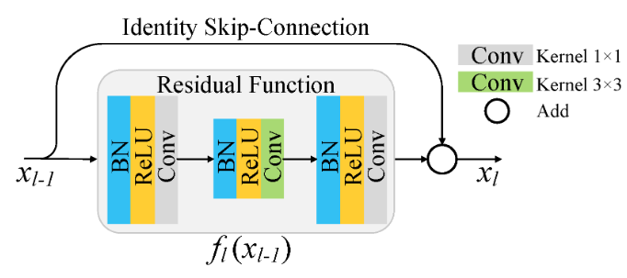
IMPROVEMENTS
Advantages of using Resnet:
Increased depth without degradation
Avoids the problem of evanescent gradients
22
Notes:
Dans les réseaux profonds traditionnels, les gradients peuvent diminuer de manière exponentielle, rendant l'apprentissage des couches plus profondes difficile. ResNet contourne ce problème en utilisant des connexions résiduelles (ou skip connections) qui permettent au gradient de se propager directement à travers le réseau.
En termes simples, au lieu de simplement sortir f(x), le bloc résiduel sort x + f(x). Cela aide le réseau à apprendre plus facilement les différences ou "résidus" nécessaires à l'amélioration des prédictions. Éviter le vanishing radiant

Slide 23
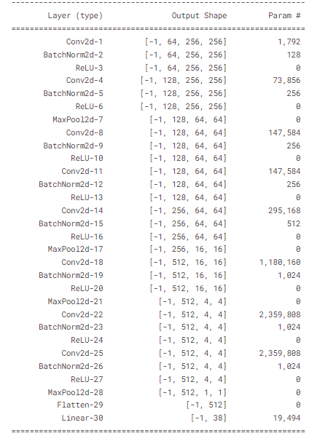
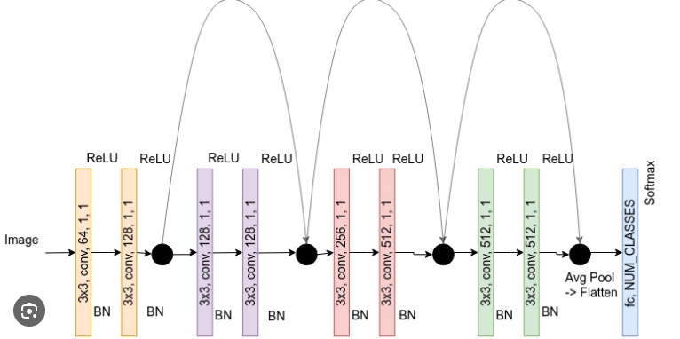
IMPROVEMENTS
Resnet9
Convolution block
Convolution block
Residual block
23
Notes:
Classe ResNet9 : Implémente une version simplifiée de ResNet avec 9 couches.
self.classifier : Composé d'une couche de max pooling, d'une couche d'aplatissement (flatten) et d'une couche linéaire pour la classification finale.
When using nn.CrossEntropyLoss as your loss function, it internally applies LogSoftmax to the logits, so you do not need to add a Softmax activation function in the model itself.

Slide 24
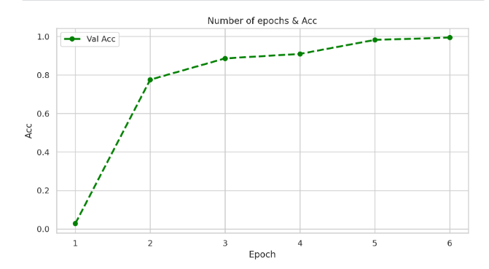
IMPROVEMENTS
24
Notes:
Weight Decay: We also use weight decay, which is a regularization technique which prevents the weights from becoming too large by adding an additional term to the loss function.
Gradient Clipping: Apart from the layer weights and outputs, it also helpful to limit the values of gradients to a small range to prevent undesirable changes in parameters due to large gradient values. This simple yet effective technique is called gradient clipping.
val_accuracy: 0.99

Slide 25
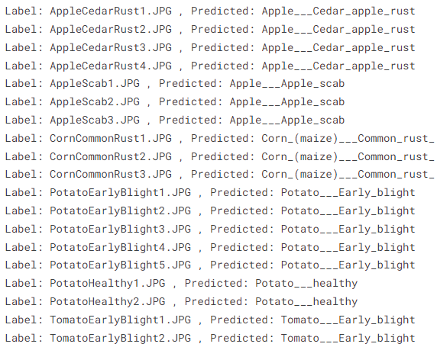
IMPROVEMENTS
Finally, using ResNet, here are our new results :
33 predictions are true
33/33
Accuracy = 100%
25

Slide 26
CONCLUSION

Slide 27
CONCLUSION
First attempts
Trying to improve results
Using CNN
Using ResNet
28 predictions true
33 predictions true
5 predictions false
Accuracy ≈ 85%
Accuracy = 100%
🙂
🥳
Good
Excellent
27
Notes:
We initially already had quite a good score
However improvement was still possible. We managed to improve accuracy by using a more advanced technique : ResNet

Slide 28

THANKS FOR YOUR ATTENTION
ANY QUESTIONS ?

